Slide 1
Mechanistic analysis

Slide 2
Contents
Coupler Curves
Toggle Position
Transmission Angle
Mechanical Advantage
Acceleration Analysis
Coriolis Component of acceleration

Slide 3
Coupler Curves
Def:
  A coupler curve is the locus of a point on the coupler link.
For the mechanisms considered, the displacement of the links joined with the fixed link was the input or output of the simple mechanisms.

Slide 4
Coupler Curves
In great number of applications the output from a simple mechanism is the path traced by one of the points on the coupler link.
These paths are generally called “coupler point curves” or “coupler paths”.

Slide 5
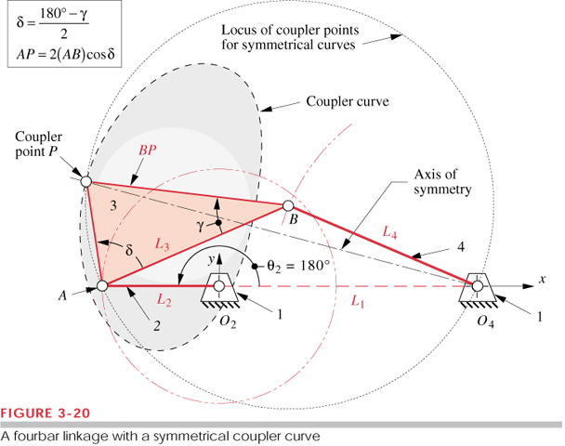

Slide 6
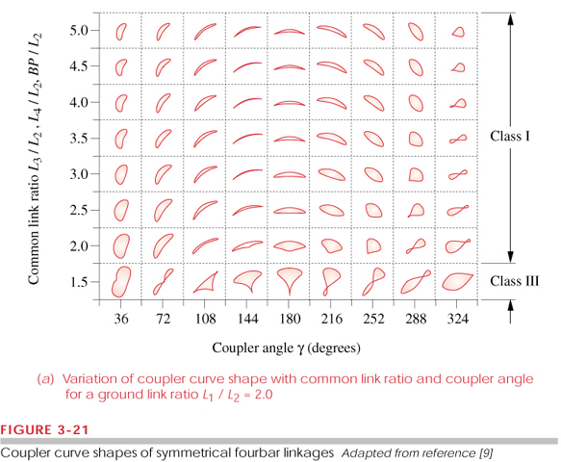

Slide 7
Toggle Position
There are various, methods and synthesis that could be used to obtain trail solution to motion control problem.
One of such rapid process is toggle position.
In this technique, one needs to check whether the mechanism reaches all the desired position without encountering a limit position.

Slide 8
Toggle Position
The toggle positions are determined by the co-linearity of two of the moving links.
Hence any mechanism at its limit of motion is known as Toggle position.

Slide 9
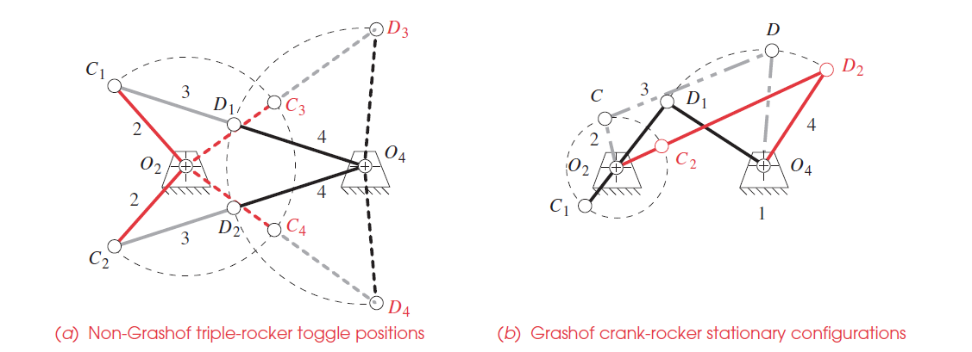
Toggle Position
Example showing toggle position technique.

Slide 10
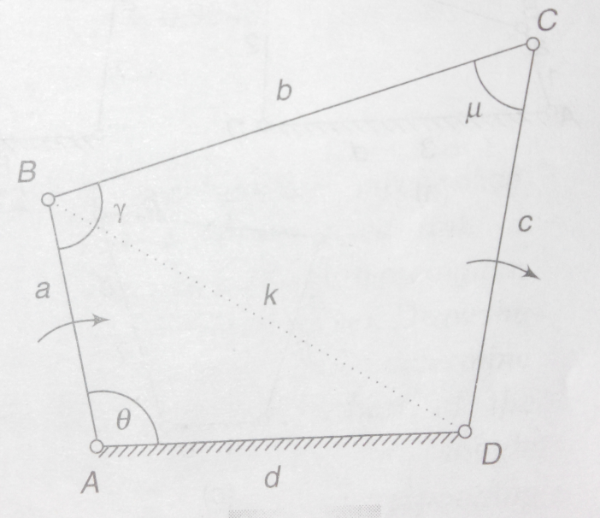
Transmission Angle
The angle µ between the output link and the coupler is known as transmission angle.
As shown in fig, if link AB is input & the force applied to output DC is transmitted through coupler BC.
For particular value of force, the
torque is max when µ is 90º.

Slide 11
Transmission Angle
When BC and DC are coincident µ is 0 and the mechanism would lock.
When µ deviates a lot from 90º, the torque on output link decreases.
Generally µ is kept more than 45º.
The max and min value of µ can be found by putting dµ/dθ equal to 0.

Slide 12
Transmission Angle
It can be seen that µ is max when θ is 180º, & min when θ is 0º.
But this happens only in double crank or rocker crank mechanism.
The max and min value of µ is both mechanisms are given in next slide.

Slide 13
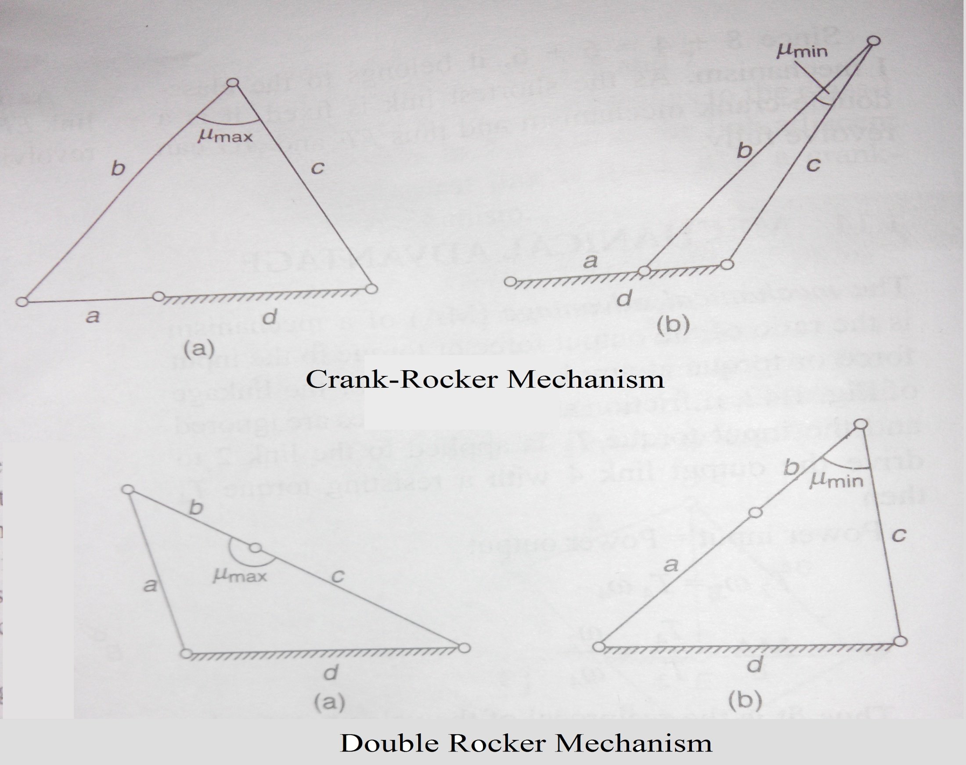

Slide 14
Mechanical Advantage
The mechanical advantage (MA) of a mechanism is the ratio of the output force/torque to the input force/torque at any instant.
In the given fig, is friction and inertia forces are ignored,
  Input torque T₂ is applied to link 2
  Output resisting torque T₄ produced at link 4

Slide 15
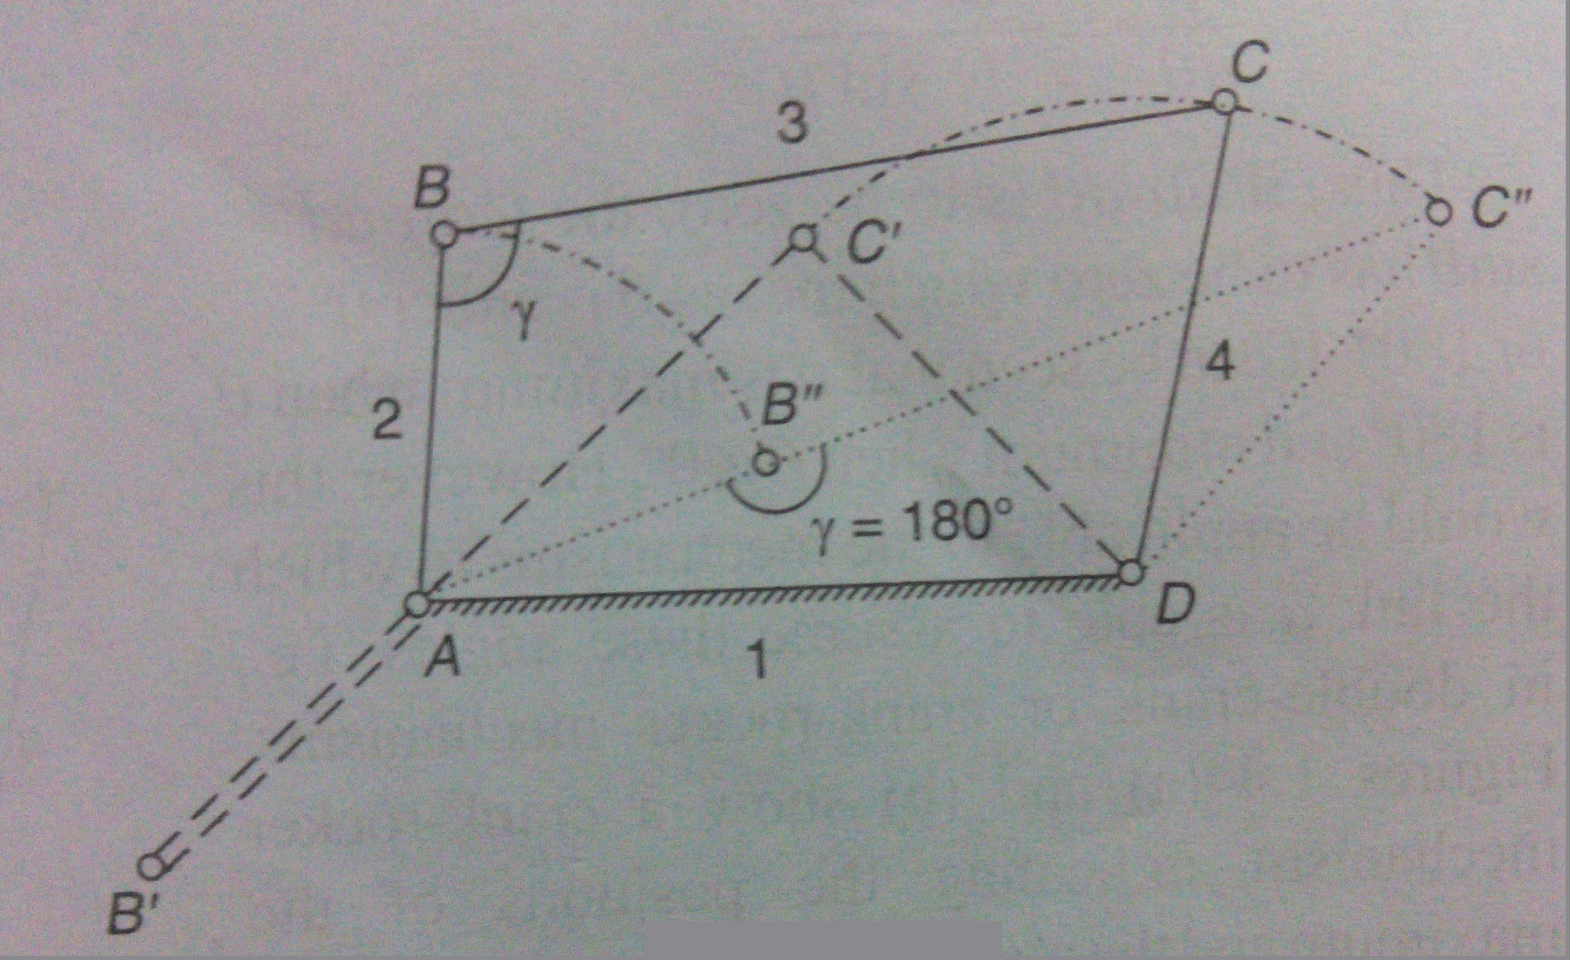

Slide 16
Mechanical Advantage
Power input = Power Output
Or MA = T₂ / T₄ = ω₂ / ω₄
Thus it is reciprocal of velocity ratio.
But in case of crank-rocker, ω₄ is 0, and γ becomes 180º or 0º, making MA infinity.
Hence only a small input torque can overcome a large output torque load.
Extreme position of linkage points are known as Toggle points.
T₂ ω₂ = T₄ ω₄

Slide 17
Acceleration Analysis
Acceleration analysis of mechanisms can be performed vectorially using the relative acceleration concept, usually starting with the given values and work through the mechanism by way of series of points A, B, C, etc.
important consideration is that the acceleration analysis cannot be performed without performing the velocity analysis since the normal and Coriolis acceleration components can only be determined after the velocity analysis.

Slide 18
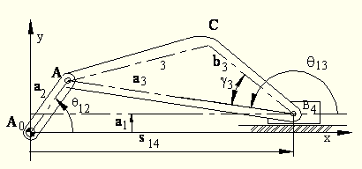
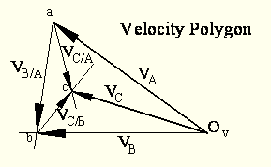
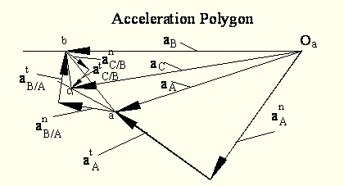
Acceleration Analysis
An Example.

Slide 19
Acceleration Analysis
The triangles abc formed on the velocity and acceleration polygons are similar to the triangle ABC of the mechanism link. The sense of abc is similar to the sense of ABC

Slide 20
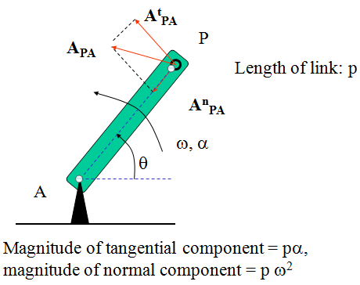
Acceleration Analysis
Acceleration of a link in pure rotation.

Slide 21
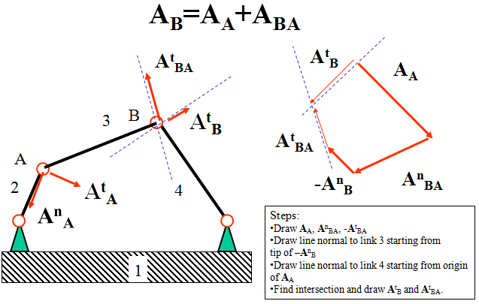
Acceleration Analysis
An Example.

Slide 22
Coriolis Component of Acc.
By derivation of the five-term acceleration equation with a spinning and translating reference frame, we see that there are two terms that appear when an object moves inside this rotating frame. One of these is Coriolis acceleration.
The Coriolis term is
𝑎⃗_{𝐶𝑜𝑟}=2Ω⃗×𝑣⃗_{𝑥𝑦}
Components of Coriolis acceleration involve only two velocities
  The rotational velocity of the rotating frame,
  the velocity of an object within this rotating frame

Slide 23
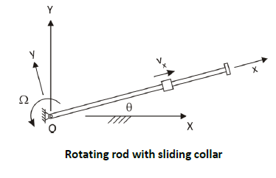
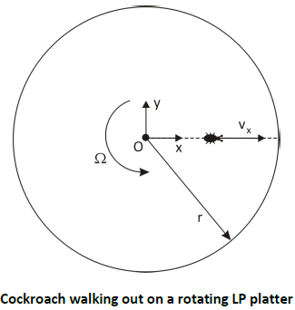
Coriolis Component of Acc.
Example a rotating rod with a
collar moving along the rod.
To understand coriolis
component of acc. Let us take an
example.
A cockroach is moving on a old Vinyl LP record.

Slide 24
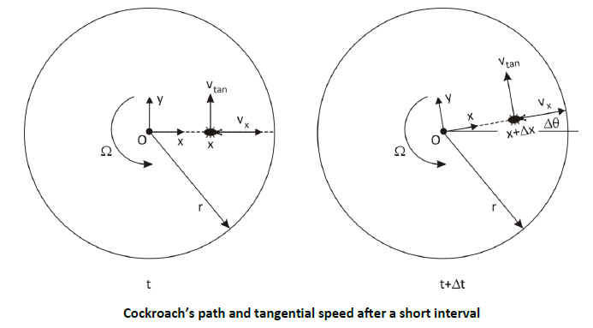
Coriolis Component of Acc.
Let’s consider the simple situation where the rotational speed Ὠ is constant and the cockroach’s walking velocity is also constant.
The following two fig shows position of cockroach at instant t and t+∆t.

Slide 25
Coriolis Component of Acc.
Coriolis acceleration = 2⋅ω⋅V_{slip}
Coriolis acceleration is normal to the radius, OP, and it points towards the left of an observer moving with the slider if rotation is counterclockwise. If the rotation is clockwise it points to the right.
To find the acceleration of a point, P, moving on a rotating path: Consider a point, P’, that is fixed on the path and coincides with P at a particular instant. Find the acceleration of P’, and add the slip acceleration of P and the Coriolis acceleration of P.
A_{P}=acceleration of P’ + acceleration of P seen from observer moving with rod + Coriolis acceleration=A_{P’} + A_{p}^{slip} + A_{P}^{Coriolis}

Slide 26
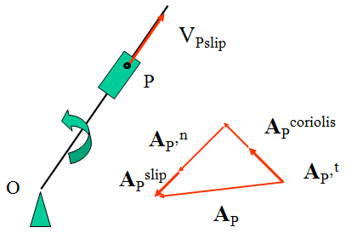

Slide 27
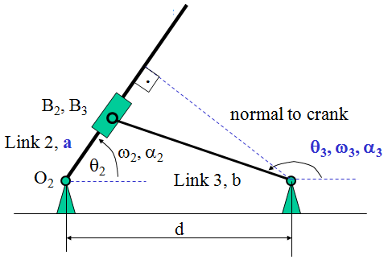
Coriolis Component of Acc.
Application : Slotted Lever mechanism.

Slide 28
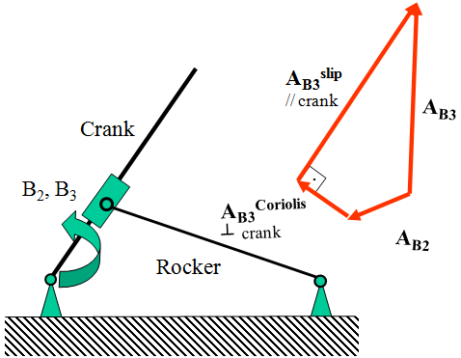

Coriolis Component of Acc.
Relation between accelerations of B₂ (on crank) and B₃ (on slider)

Slide 29

Thank You

